Slide 1

Healthcare Analytics for Doctor Visits
Sureswar Reddy Dronadula
AICTE : STU65d88623cfcc01708688931

Slide 2

Patient Segmentation:
Patient segmentation involves dividing a group of patients into subgroups based on certain characteristics, such as age, gender, or income. This segmentation helps healthcare providers understand the unique needs and behaviors of different patient groups.

Slide 3
Segmentation Criteria: Determine which demographic characteristics you want to use for segmentation. Common criteria include age, gender, income, education level, and geographic location.
Data Collection: Collect relevant patient data, including demographic information, visit history, and health metrics such as illness severity and chronic condition status.
Segmentation: Use statistical techniques or simple filters to divide the patient population into subgroups based on the chosen criteria. For example, you can divide patients into age groups (e.g., <18, 18-35, 36-50, 51-65, 65+) or income brackets (e.g., low-income, middle-income, high-income).
Analysis: Once patients are segmented, analyze visit patterns, illness severity, and chronic condition prevalence within each subgroup. This analysis helps identify trends and patterns specific to each segment.

Slide 4
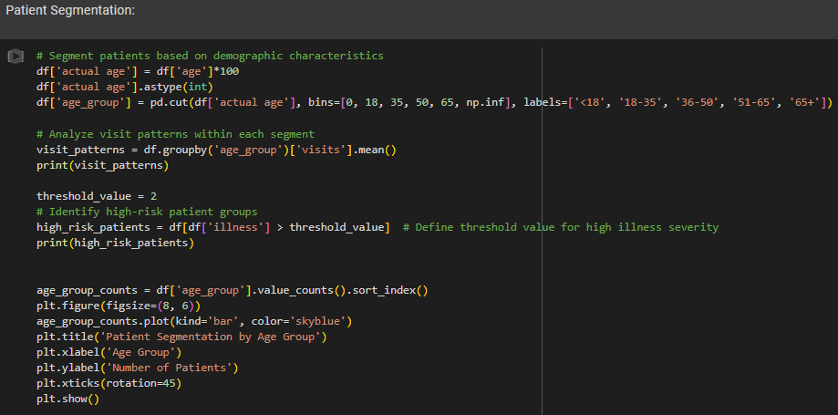
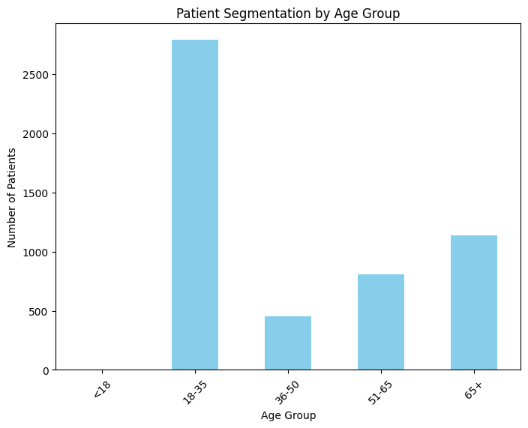
RESULTS

Slide 5
Impact of Socioeconomic Factors
When examining the impact of socioeconomic factors on healthcare utilization and health outcomes, we focus on variables such as income, which can significantly influence access to healthcare services and health outcomes..

Slide 6
Categorizing Patients by Income:
In this step, we classify patients into distinct groups or brackets based on their income levels.
Income brackets can be defined using various criteria such as annual income, household income, or socioeconomic status.
For example, we may divide patients into low-income, middle-income, and high-income groups based on predefined income thresholds or percentiles.
Analyzing Healthcare Metrics:
Once patients are categorized by income, we examine various healthcare metrics to understand how income levels impact healthcare utilization and health outcomes.
Healthcare metrics may include:
Illness Severity: The severity or acuteness of illnesses experienced by patients.
Chronic Condition Prevalence: The prevalence or frequency of chronic health conditions such as diabetes, hypertension, or heart disease.
Healthcare Utilization: The frequency and type of healthcare services utilized by patients, including doctor visits, hospitalizations.

Slide 7
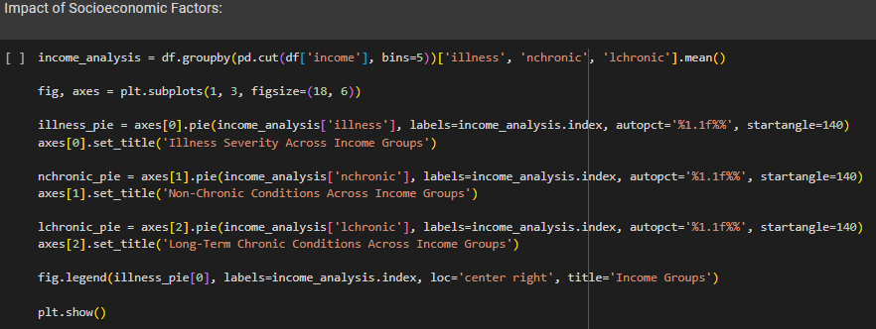
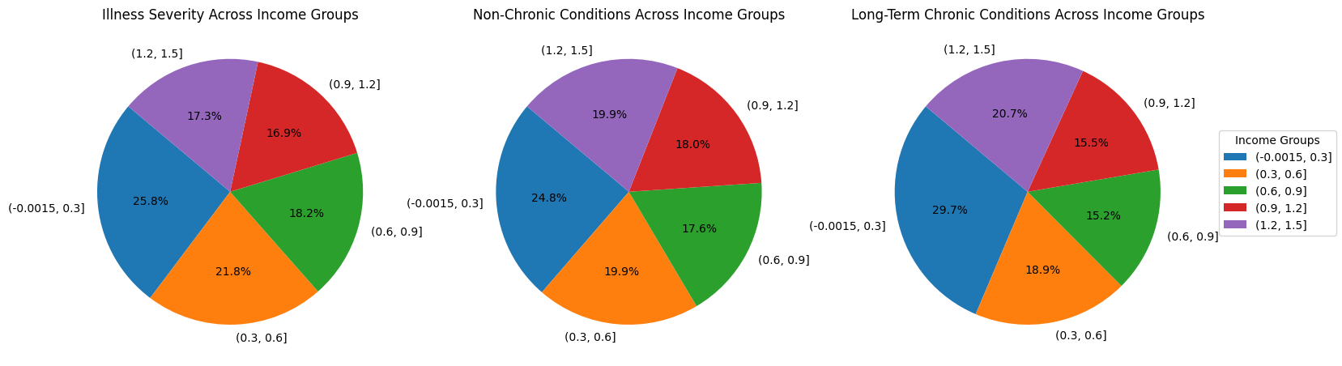
RESULTS

Slide 8
Correlation Analysis :
Correlation analysis is a powerful tool in healthcare data analysis for understanding relationships between variables and identifying potential factors influencing health outcomes.

Slide 9
Understanding Correlation:
Correlation analysis examines the relationship between two or more variables to determine if changes in one variable are associated with changes in another.
A positive correlation indicates that as one variable increases, the other variable also tends to increase. Conversely, a negative correlation means that as one variable increases, the other variable tends to decrease.
Interpreting Correlation Results:
Positive correlations suggest that as one variable increases, the other tends to increase as well. For example, a positive correlation between illness severity and chronic conditions indicates that patients with more chronic conditions tend to have higher illness severity.
Negative correlations imply that as one variable increases, the other tends to decrease. For instance, a negative correlation between income and hospitalization rates suggests that higher-income individuals may have lower hospitalization rates.
Visualizing Correlations:
Correlation matrices and scatter plots are commonly used to visualize correlations between multiple variables.
Heatmaps can also be used to represent correlation matrices visually, with colors indicating the strength and direction of correlations.

Slide 10
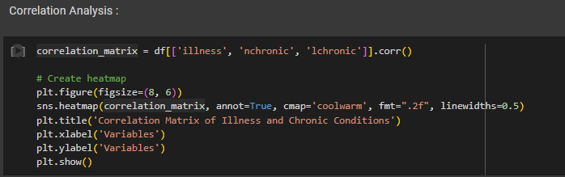
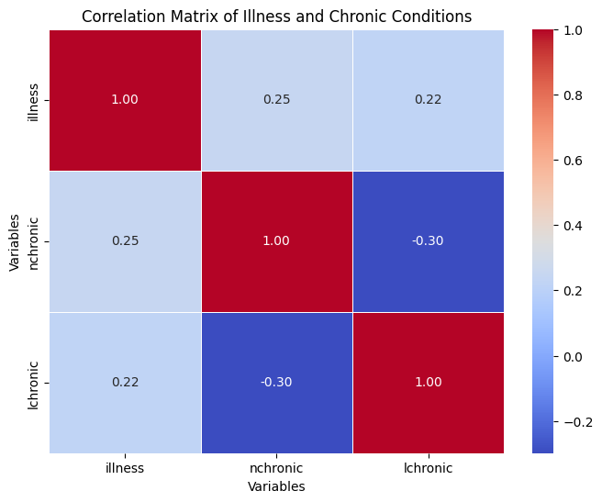
RESULTS

Slide 11

END USERS :
Healthcare Providers and Clinicians:
Healthcare providers, including doctors, nurses, and allied health professionals, use the analyses to understand patient demographics, identify high-risk groups, and tailor treatment plans to individual patient needs.
Healthcare Administrators and Managers:
Healthcare administrators and managers use the analyses to optimize resource allocation, improve operational efficiency, and identify areas for quality improvement.
Public Health Professionals:
Public health professionals use the analyses to identify population health trends, monitor disease prevalence, and develop public health interventions and policies.
Researchers and Academics:
Researchers and academics use the analyses to conduct epidemiological studies, evaluate healthcare interventions, and contribute to the evidence base for clinical practice and policy.
Policy Makers and Government Agencies:
Policy makers and government agencies use the analyses to inform healthcare policies, funding decisions, and regulatory initiatives.

Slide 12

Technology Used
Python
pandas
NumPy
Matplotlib
seaborn
scikit-learn
Jupyter Notebook

Slide 13
Thank you
Healthcare Analytics for Doctor Visits -Github Link

